Slide 1
Domain Name Servers Installation
DAW2-WEB Deployment CIFP Camino de la Miranda

Slide 2
Index
Introduction
Flat and hierarchical name systems.
Domain name spaces.
Top level domains: generic and geographic.
Delegation DNS.
Primary and secondary zones.
DNS databases: structure and type of records.

Slide 3
Introduction
•On the Internet, all computers work thanks to a set of protocols, including the IP protocol. The IP protocol uses 32-bit addresses to identify the various nodes on the Internet. To facilitate the task of its manipulation, when we handle an IP address, we organize the address in groups of 8 bits and represent the address in this way: 209.85.227.103.
•However, its handling is still cumbersome as we find it difficult to remember that, this IP address corresponds to the Google website. Humans find it much easier to remember www.google.com than a 4-digit set.
•DNS is intended to facilitate this task. DNS allows you to translate an address of the type www.google.com to an IP address and vice versa.

Slide 4
2. Flat and hierarchical name systems.

Slide 5
2. Flat and hierarchical name systems.
In general, we can classify naming systems into two large groups:
•Flat name systems: those in which there is no hierarchy to classify a computer into a category (category could be a geographical location or, for example, that computer’s membership of the sales department versus accounting). An individual’s ID number is an example of a flat name system: the ID number identifies a person but does not indicate where that person lives.

Slide 6
2. Flat and hierarchical name systems.
•Hierarchical name systems: those in which there is a hierarchy when it comes to building the full name of a computer. In this case, by reading the full name of a computer, you can determine its geographical location or which department it belongs to within the company.
For example, a person’s postal address is an example of a hierarchical name system: a letter must always show the country, the province, the population, the street, etc., that allows to identify a person, Distinguish it from another one that is called the same but lives elsewhere and locate it geographically.

Slide 7
2. Flat and hierarchical name systems.
•A flat domain name system is much simpler than a hierarchical one, however the domain name system (DNS) used on the Internet is hierarchical, facilitating the work of enterprise network administrators, so that they can assign names to their computers without having to take care that it does not match any other in any other part of the world.
•Using this type of system, you can put the name you want to a PC. The only limitation is that, of course, there cannot be two PCs that are called alike within the same company (unless subdomains have been created, but we will see that).

Slide 8
2. Flat and hierarchical name systems.
•On the other hand, a flat name system implies a centralized and unique management for the entire namespace (to monitor for name conflicts). On the contrary, a hierarchical name system allows a distributed management so that each entity or company can manage its namespace autonomously.
•DNS is not the only naming system. For example, in Windows networks, WINS is used to perform similar functions than DNS when it is not configured on a network. We will focus exclusively on the DNS system because it is used on the Internet.

Slide 9
2. Flat and hierarchical name systems.
•In the 1970s, when the predecessor of the Internet (ArpaNET) was created, the naming system used was flat. In fact, there was a file called hosts.txt that was updated twice a day and that all computers had to copy if they wanted to connect with the new elements.
Activity 1: find the hosts file on your computer and open it, what conclusions do you draw from what you read in it?

Slide 10
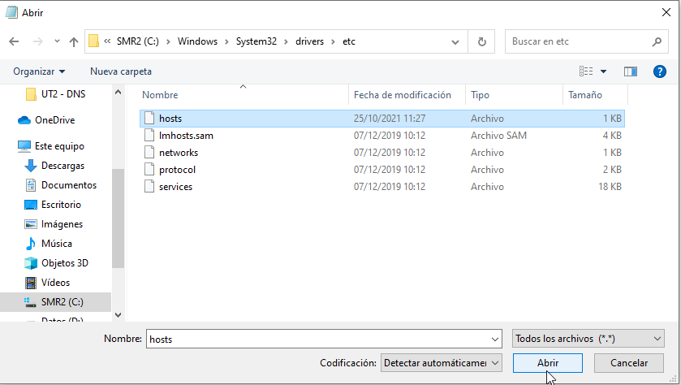
C:\Windows\System32\drivers\etc

Slide 11
Domain name spaces

Slide 12
3. Domain name spaces
It is define by the RFC 1034 for the IPv4 protocol
•The domain namespace specified in the DNS has an inverted tree structure.
The beginning of the tree is called the root of the DNS system and has an empty tag. The end of the tree is called the sheet.

Slide 13
3. Domain name spaces
•An example of this structure is shown in the figure. The root of the tree is represented by a circle while the rest of the elements are represented either by a circle (if it is an internal element) or by a square (if it is a leaf).

Slide 14
3. Domain name spaces
•As can be seen, the depth of the tree is not the same on all branches. There are only two limitations: the 63 character limit referred to above and the maximum number of levels, which cannot exceed 127 (in our example we have 5 levels, including the root).
•In short, the domain namespace used in the DNS resembles a directory structure that we can find in Linux or in Windows, the directories would be the circles and sheets the files.

Slide 15
3. Domain name spaces
•The search for a tree direction is from the root to the leaf.
•Although the DNS tree is traversed from the root, we humans read and write the domain names just the other way around and separate each element by the "." ; in this way we read and write: www.google.com and not com.google.www.

Slide 16
3. Domain name spaces
•The root has no label. The root element label is usually considered to be the null character.
•Each of the circles represents a distinct domain and comprises that element and all who "hang" from it. Thus, the domain "is" includes the domains "rediris.es" and "fictitious.es" as well as everything that hangs from these two. That is, both "www.cont.ficticio.es" and "www.rediris.es" are within the domain "es". A domain will therefore be any subtree of the hierarchy.

Slide 17
3. Domain name spaces
•We usually speak of n-level domains to refer to their location within the hierarchy. Thus, "com" is a first level domain and "cont.ficticio.es" is a third level domain.
•Top-level domains are usually called TLD and, for administrative purposes, are divided into two major groups: generic domains (gTLD, Generic Top-Level Domain) and geographical domains (ccTLD, Country-Code Top-Level main). From a technical point of view, all domains, including TLDs, are managed the same, but from an administrative point of view TLDs have a different management and therefore appear differentiated in the figure.

Slide 18
3. Domain name spaces
Normally the sheet elements correspond to the name given to a computer ("hostname" in Linux or "Computer name" in Windows). This way "mail", "serv1" or "pc-dire" would be the names of the computers. The rest, "rediris.es", "vent.ficticio.es" or "cont.ficticio.es" is what is called domain.
Therefore, there are two elements when defining the full name of a computer by DNS: on the one hand the name of the computer «pc-dire», «pc-adela», «pc-antonio», etc. and on the other hand the name of the domain to which it belongs: «rediris.es», «google.com», «cont.ficticio.es».

Slide 19
3. Domain name spaces
•The sum of both is the full name, for example "pc-adela.cont.ficticio.es." , in DNS terminology this is called FQDN (Fully Qualified Domain Name).
•The most important thing about the DNS system is that the management of each domain is independent. That is, there is an entity that manages the domain <<.es>> that is called Red.ES that is independent of the entity that manages, for example, "fictitious.es".

Slide 20
3. Domain name spaces
•The company that owns the domain ".ficticio.es" adds and removes the nodes under its domain completely independent of the entity that manages the parent domain ". is".
•This process is called delegation and we will see about it later.

Slide 21
3. Domain name spaces
Activity 2: Research the names of the four reserved domains used for testing online (.test,.example,.invalid,.localhost)
Activity 3: complete the table.
 | Meaning |  | Meaning
.com | Generic (Commercial) | .pt | Geografical (Portugal)
.org | Generic (Organización) | .uk | Geografical (United Kingdom)
.net | Generic (Network) | .edu | Generic
.eu | Geografical (European Union) | .gov | Generic (Govermment)
.sc | Geografical (Seychelles) | .info | Generic ()

Slide 22
4. Generic and geographic top-level domains
Top level domains are classified into three large families:
•Generic domain names
•Geographical domains
•ARPA domains

Slide 23
4. Generic and geographic top-level domains
1 gTLD (Generic Top-Level Domain) generic domains are those that have three or more letters: ". com", ". org", ". cat", ". info", ". name", ". pro" are some examples.
2 Geographical domains: ccTLD (Country-Code Top-Level Domain) are those domains formed exclusively by two letters and, in general terms, refer to a country: ". is", ". uk", ". us", ". fr", ". eu",...
3 Domain . arpa: this domain is an exception (it should have been considered generic) and is therefore classified separately. The domain ". arpa", as we will see, is not used to get the IP address of a name but just for the opposite: to get the domain name of a certain IP address. This is known as reverse resolution.

Slide 24
4. Generic and geographic top-level domains
•Starting in 2000, a division was established within generic domains.
1 Non-proprietary domains (uTLDs): those that operate according to the rules of ICANN (the entity that manages the TLDs) and therefore with policies of use established globally on the Internet. That is, they are not sponsored by anyone. It is: . biz, . com, . info, . mame, . net, . org and .pro.
2 Sponsored Domains (sTLDs) are those that operate according to specific rules determined by an entity that somehow supports that sponsorship. It is this entity that determines its use policy. It is: . aero, . asia, . cat, . coop, . edu, . gov, . int, Jobs, . mil, . mobi, . musseum, . tel and .travel.

Slide 25
4. Generic and geographic top-level domains
•Geographical domains are those that have two letters and are related to countries or territories.
•In this case, all management tasks, including defining usage policies, are delegated to an entity in that country or territory which will define the conditions under which names may be registered under that domain.
•In general terms it is the government of each specific country that determines the entity that will manage the domain.

Slide 26
4. Generic and geographic top-level domains
Geographic domains are created by ICANN or, more specifically, by a department of this called IANA (Internet Assigned Numbers Authority).
Knowing how controversial the issue may be, IANA uses the list defined in the ISO-3166 standard to determine both the listing and the two-letter code to be assigned.

Slide 27
4. Generic and geographic top-level domains
RESERVED DOMAINS
The reason for doing this is to use non-existent domains when performing various tests on the DNS service. Specifically, four reserved domains have been defined: . test, . example, . invalid, .localhost.
. test: to be used when testing DNS-related source code.
. localhost: must point to loopback address: 127.0.0.1

Slide 28
4. Generic and geographic top-level domains
. example: when doing DNS documentation, you should use this domain to avoid conflicts with the real world if, by chance, someone came up with the idea of moving those examples to a real DNS server without modifying anything.
. invalid: it must be used when you are configuring a DNS server connected to the DNS hierarchy and you want to do tests that do not affect the normal functioning of our network.

Slide 29
4. Generic and geographic top-level domains

Slide 30
4. Generic and geographic top-level domains
Let’s see how domain buying and selling works.
•ICANN is the entity that "decides" which top level domains will exist.
•Internet users (individuals and businesses) can only purchase second level domains.
For this reason, a way of functioning is established in which a series of actors appear who, unfortunately, have very similar English names: registry, registrar and registrant.

Slide 31
4. Generic and geographic top-level domains
•Domain Registration (registry): ICANN, once it has created a TLD cedes technical and bureaucratic control to an institution. That institution is the domain registration. The registry is responsible for keeping the DNS servers associated with that top level domain running. Registration, therefore, is the entity that technically registers and drops the second level domains that are under it.

Slide 32
4. Generic and geographic top-level domains
•Domain registrar (registrar): usually the registry does not directly serve users who want to buy a domain but do so through intermediaries. The task of serving users, as if it were a retail market, is domain registrars. They attend to the client’s request, check that it is correct, receive payment and then request the request on behalf of the client to the corresponding domain registry, for which they must pay a fee. Sometimes, this process is repeated twice and, therefore, there are registrars who attend to other registrars.

Slide 33
4. Generic and geographic top-level domains
•Registrant user (registrant): is the person or company who actually buys the domain and who will use it for their own benefit. The ownership of the second level domain is, in any case, the registrant and never the registrar. In fact, similar to what happens with the telephony service, the user could decide to change the registrar if another one offers better services.

Slide 34
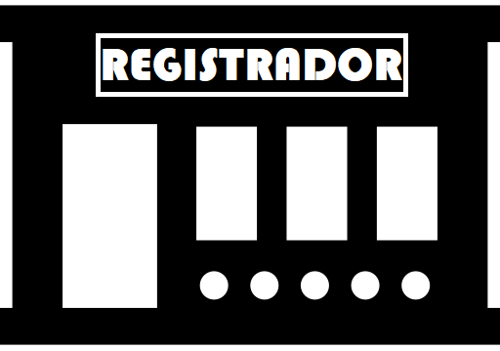

Registrante
Imágenes tomadas de Flaticon

Slide 35

REGISTRO
Imágenes tomadas de Flaticon

Slide 36
4. Dominios de primer nivel genéricos y geográficos
Activity 4: Search the IANA website for information about the entity registering the domains . cat, . es, . eu, . com and .org.
Activity 5: Search the internet to find the two types of DNS servers and explain us their function
What are the Authoritative vs Non-authoritative DNS Servers – TecAdmin

Slide 37
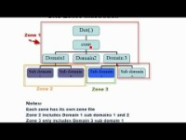
5 DNS Delegation
Football leage example
https://www.youtube.com/watch?v=JDc9IZVFLm0

Slide 39
6 Primary and Secondary Zones
A DNS zone is a distinct part of the domain namespace which is delegated to a legal entity.
A DNS zone is also an administrative function, allowing for granular control of DNS components, such as authoritative name servers.
When a web browser or other network device needs to find the IP address for a hostname such as “example.com”, it performs a DNS lookup - essentially a DNS zone check - and is taken to the DNS server that manages the DNS zone for that hostname. This server is called the authoritative name server for the domain. The authoritative name server then resolves the DNS lookup by providing the IP address, or other data, for the requested hostname.

Slide 40
6 Primary and Secondary Zones
DNS servers can be deployed in a primary/secondary topology, where a secondary DNS server holds a read-only copy of the primary DNS server’s DNS records.
The primary server holds the primary zone file, and the secondary server constitutes an identical secondary zone.
DNS requests are distributed between primary and secondary servers.
A DNS zone transfer occurs when the primary server zone file is copied, in whole or in part, to the secondary DNS server.

Slide 41
7. DNS databases: structure and type of records.

Slide 42
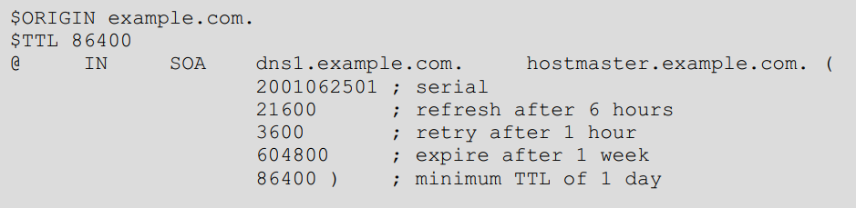
7. DNS databases: structure and type of records.
DNS Zone files start with two mandatory records:
Global Time to Live (TTL), which specifies how long records should be keet in local DNS cache. $TTL
Start of Authority (SOA) record—specifies the primary authoritative name server setting for the DNS Zone.

Slide 43
7. DNS databases: structure and type of records.
dns1.example.com Indicates the domain name of the zone’s primary server.
Hostmaster.example.com: Indicates the email address of the person responsible for that area. If we replace the first"." with a "@", we already have an email address.
Serial: it is used by the secondary servers to know if the copy they have of the zone is updated or not. To do this, they compare the serial number they have with the one they publish the main. Children are updated if the serial number that the parent publishes is greater than that child. Any numbering scheme is valid as long as the serial number increases with each update. However it is recommended to use the YYYYMMDnn format.
Refresh: indicates how often the slave should contact the primary to check if the zone has been updated.
Retry: how often the child must retry a zone update. That is, if after the first attempt to check the zone (time set in "update"), the primary is not accessible, the following retries (until you get contact with the primary) will be made according to the interval specified in this field.
Expire: indicates the time, in seconds, during which a secondary may not contact the primary to check the area. If that time is exceeded, the secondary will consider that something strange has happened and erase all the data he had about that area and declare himself as not authoritative for the area.
Minimum TTL: the time during which a negative response must be stored in the cache of any DNS server. With the value in the example, that means that if another DNS server asks for "no-exists.lickmyfeet.es" and that entry does not exist, that DNS server will consider that answer (does not exist) valid for 2 days.

Slide 44
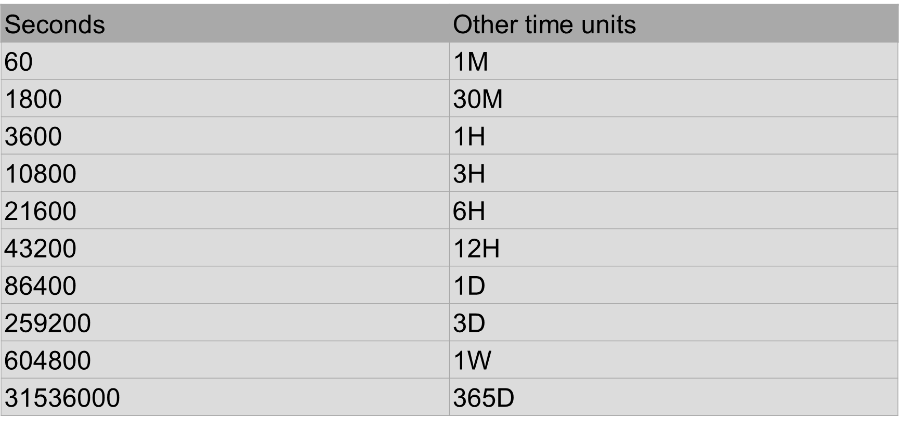
7. DNS databases: structure and type of records.

Slide 45
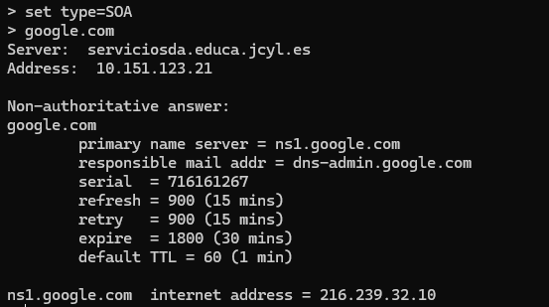
7. DNS databases: structure and type of records.
Activity : Using the “nslookup" program, get the SOA from "<google.com>" How often are the secondary servers updated? To whom should an email be sent in case of problems with the domain?
Activity : Repeat the previous activity for the domain you want.

Slide 46
7. DNS databases: structure and type of records.
DNS Zone Records
Name is an alphanumeric identifier of the DNS record. It can be left blank, and inherits its value from the previous record.
TTL (time to live) specifies how long the record should be kept in the local cache of a DNS client. If not specified, the global TTL value at the top of the zone file is used.
Record class indicates the namespace—typically IN, which is the Internet namespace.
Record type is the DNS record type—for example an A record maps a hostname to an IPv4 address, and a CNAME is an alias which points a hostname to another hostname.
Record data has one or more information elements, depending on the record type, separated by a white space. For example an MX record has two elements—a priority and a domain name for an email server.

Slide 47
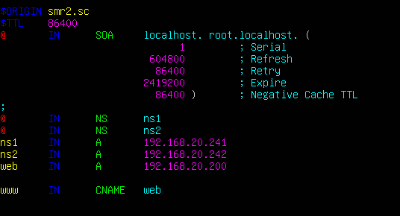
7. DNS databases: structure and type of records.

Slide 48
7. DNS databases: structure and type of records.
After these two records, the zone file can contain any number of resource records, which can include:
Name Server records (NS)—specifies that a specific DNS Zone, such as “example.com” is delegated to a specific authoritative name server
IPv4 Address Mapping records (A)—a hostname and its IPv4 address.
IPv6 Address records (AAAA)—a hostname and its IPv6 address.
Canonical Name records (CNAME)—points a hostname to an alias. This is another hostname, which the DNS client is redirected to
Mail exchanger record (MX)—specifies an SMTP email server for the domain

Slide 49
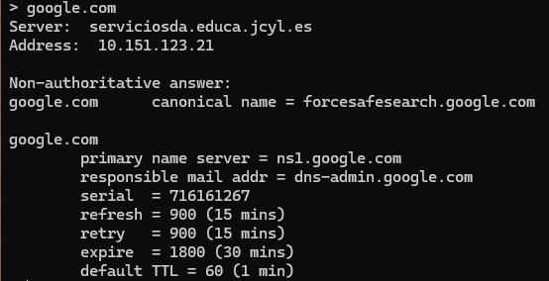
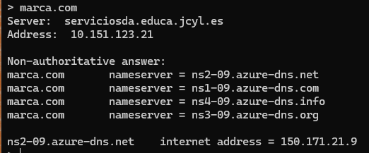
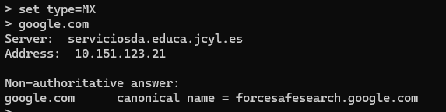
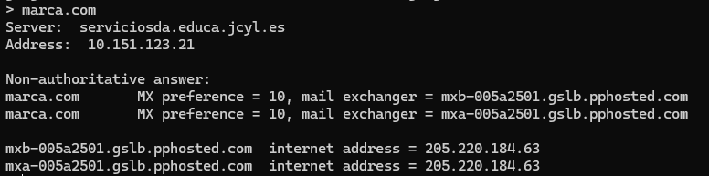
7. DNS databases: structure and type of records.
Activity: Using nslookup, get google.com NS entries, how many servers exist for that area?
Activity: Repeat the previous activity for the domain you want.
Activity: Find the MX values of gmail.com.
Activity: Find the MX values of a second level domain of your choice.
Activity: Using nslookup, get the IP address (A records) of one of google.com’s nameservers.
Activity: Repeat the previous activity with any domain.

Slide 50
7. DNS databases: structure and type of records.
Activity: Using the dig program, get the CNAME entries from google.com.
Activity: Repeat the previous activity for the domain you want.
Activity: Use "dig" to search for the name server list of the upm.es domain and then query one of those servers for any record with the name upm.es.
Activity: if the servers in the zone "us.es" were "onix.us.es", "jade.us.es" and "dns1.cica.es", with respective addresses 150.214.186.69, 150.214.130.15, 150.214.5.83, what RR should exist in the zone ". is"?

Slide 51
7. DNS databases: structure and type of records.
Activity: What RR would you need in the "mi-empresa-sa.es" zone to indicate that I have a server called "titan" that offers web, email and ftp services?
Activity: indicates in a reasoned way the necessary records, and the zone where the records must be, in the case of having a zzz.net domain, with the following characteristics: four DNS servers: dns1.xyz.com; dns1.zzz.net, ns0.abc.net and dns1.zzz.org, In the domain there is a computer called smr2, which is web and mail server and another computer called smr1, which acts as ftp and mail server. Choose the IP addresses you want for the servers.

